Slide 1
Toronto Dataset
By-Shaily Jindal

Slide 2
About Toronto City
Toronto is the capital city of the Canadian province of Ontario. With a recorded population of 2,731,571 in 2016, it is the most populous city in Canada and the fourth most populous city in North America. The city is the anchor of the Golden Horseshoe, an urban agglomeration of 9,245,438 people (as of 2016) surrounding the western end of Lake Ontario, while the Greater Toronto Area (GTA) proper had a 2016 population of 6,417,516. Toronto is an international centre of business, finance, arts, and culture, and is recognized as one of the most multicultural and cosmopolitan cities in the world.

Slide 3
About the data source
Link- https://en.wikipedia.org/wiki/List_of_postal_codes_of_Canada:_M
This is a list of postal codes in Canada where the first letter is M. Postal codes beginning with M are located within the city of Toronto in the province of Ontario. Only the first three characters are listed, corresponding to the Forward Sortation Area.
Canada Post provides a free postal code look-up tool on its website, via its applications for such smartphones as the iPhone and BlackBerry, and sells hard-copy directories and CD-ROMs. Many vendors also sell validation tools, which allow customers to properly match addresses and postal codes. Hard-copy directories can also be consulted in all post offices, and some libraries.

Slide 4
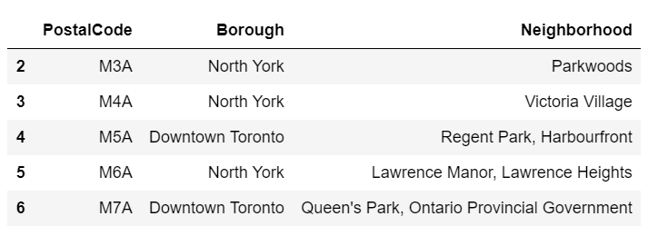
Example of data-set from origin

Slide 5
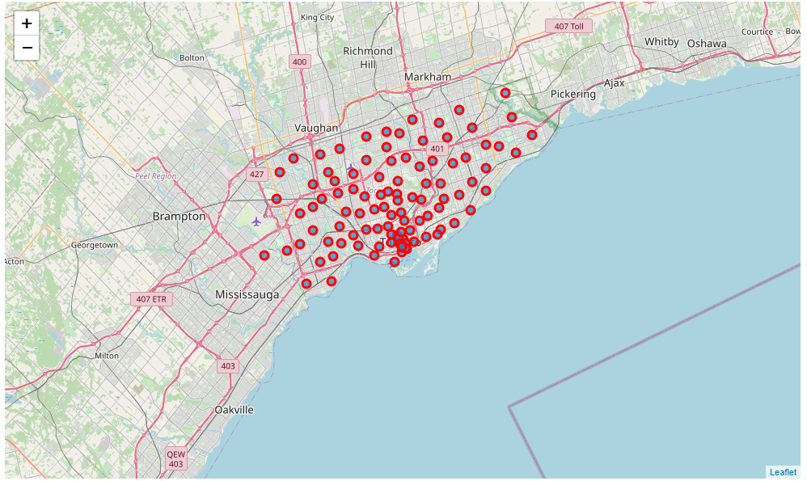
Plotting of available points
Another data set was used for combining postalcodes with latitude and longitude of the data
Map for datapoints available—

Slide 6
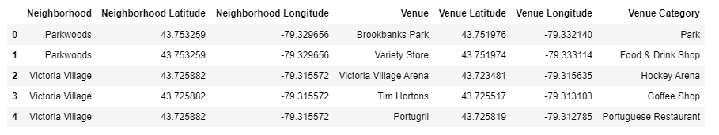
Final Dataset for analysis and clustering
Finally using foursquare API we created dataset including neighbourhoods, venue name, venue category and it’s coordinates for analysis.

Slide 7
After out analysis
Total number of restaurants: 483
Total number of Italian restaurants: 40
Percentage of Italian restaurants: 8.28%
This is good number to start as no is very less.
Looking good. So now we have all the restaurants in area within few kilometres from Downtown Toronto, and we know which ones are Italian restaurants! We also know which restaurants exactly are in vicinity of every neighbourhood candidate centre.
This concludes the data gathering phase - we're now ready to use this data for analysis to produce the report on optimal locations for a new Italian restaurant!

Slide 8
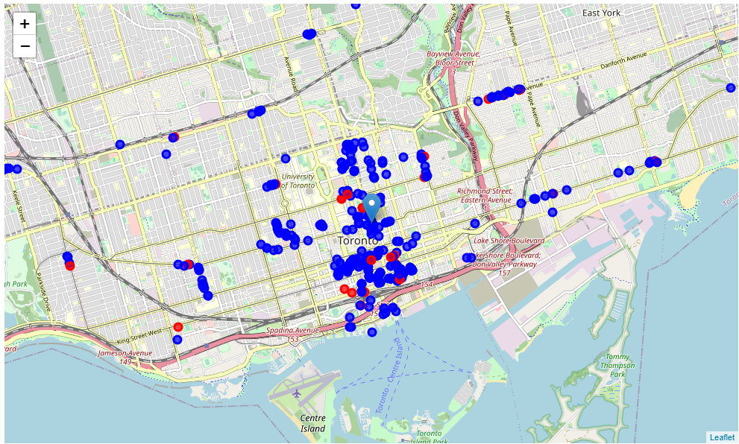
Red shows Italian restaurants, blue shows restaurants

Slide 9
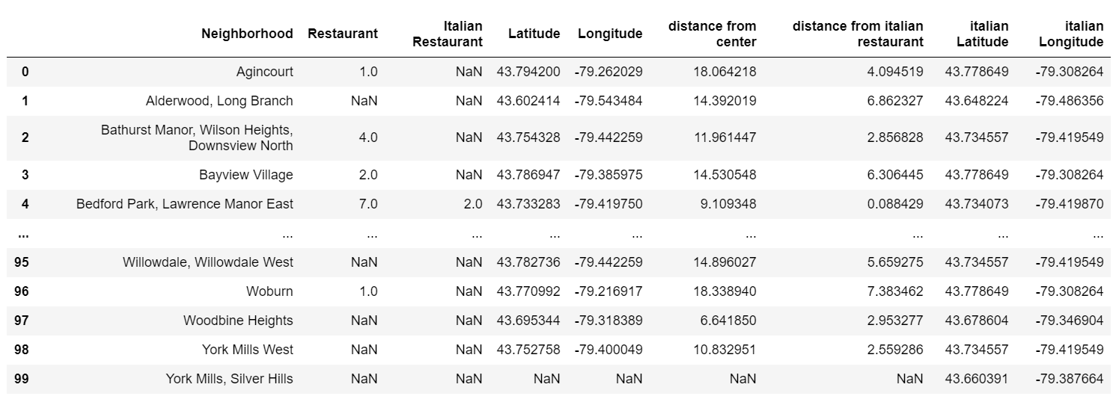
Number of localities with no italian restaurant is 74
Number of localities with no restaurant is 36
After this I added latitude and longitudes of nearest Italian restaurants as well as distance from centre and Italian restaurants.

Slide 10
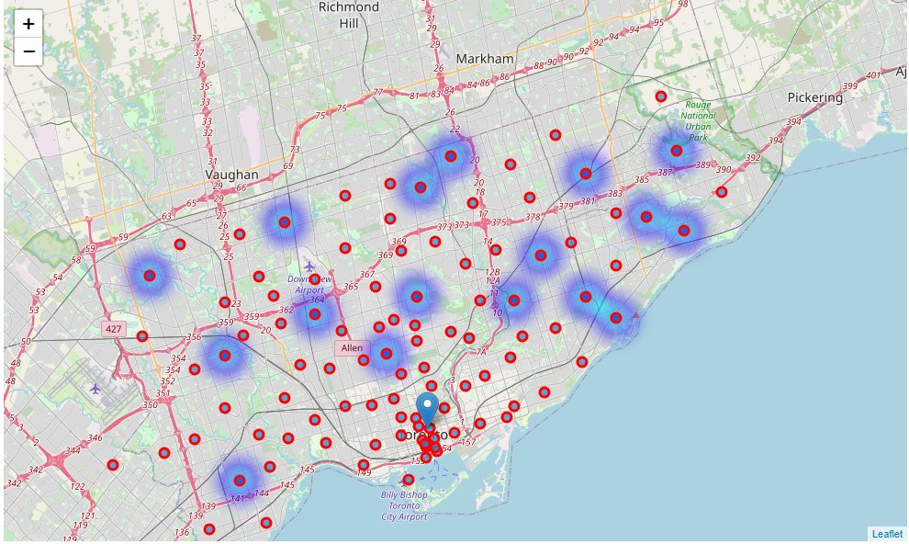
All the good locations centres

Slide 11
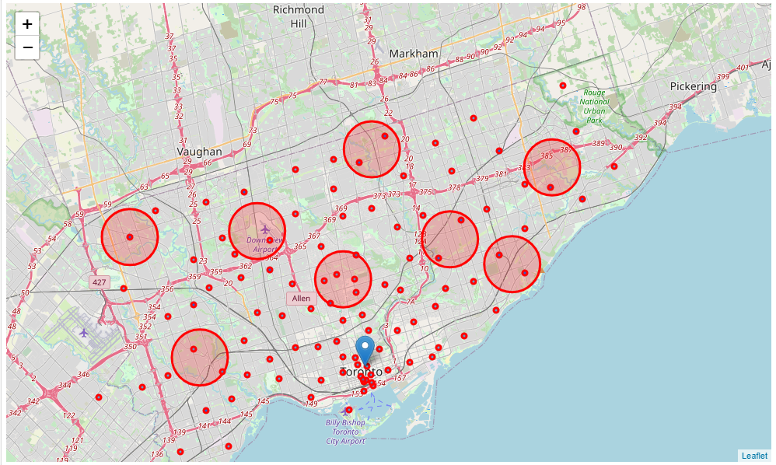
Best possible clusters

Slide 12
Result and conclusion
Result of all this is 8 zones containing largest number of potential new restaurant locations based on number of and distance to existing venues - both restaurants in general and Italian restaurants particularly. This, of course, does not imply that those zones are actually optimal locations for a new restaurant! Purpose of this analysis was to only provide info on areas close to downtown toronto but not crowded with existing restaurants (particularly Italian) - it is entirely possible that there is a very good reason for small number of restaurants in any of those areas, reasons which would make them unsuitable for a new restaurant regardless of lack of competition in the area. Recommended zones should therefore be considered only as a starting point for more detailed analysis which could eventually result in location

